Slide 1
Packaging Highlights for ChP EM
This file is meant to provide quick reference to common packaging issues.
It does not include all supplier packaging requirements.

Slide 2

Pallet Requirements
ChP PS-EM Logistics
Max pallet height = 1000mm
Max pallet weight = 1000kg
Unit load must be stackable on itself (2 or greater on the PDS)
Components planned for returnable packaging:
  A back up expendable packaging concept is mandatory for parts in returnable packaging.
    These components pallet quantities MUST match returnable concepts for repacking!
    Expendable backup must be defined by supplier and accepted by Bosch (PDS)
  System Housing: 8 pcs/pallet
  B-Sheild: 40 pcs/pallet
  Gearbox Cover: 36 pcs/pallet
  Stator Stack / Rotor Stack: 88 pcs/pallet
  Differential: 110 pcs/pallet
  Intermediate Shaft: 210 pcs/pallet
All other component pack quantities should be in multiples or factors of 24pcs

Slide 3
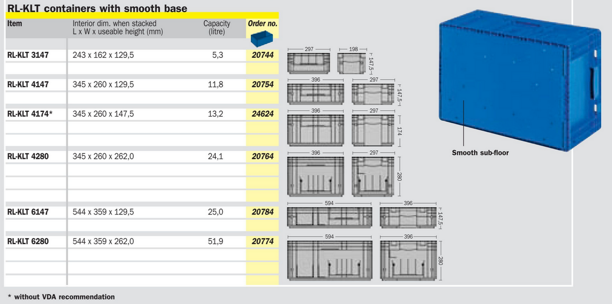
Sub-Pack Requirements for Repack in ChP
ChP PS-EM Logistics
The contents of supplier sub-packs must fit into one of the tote sizes shown below
Each sub-pack should contain as few bags as possible
Individual bags may not exceed 14kg

Slide 4
Labeling Requirement Highlights
ChP PS-EM Logistics
Scanning of labels for system transactions is critical for the process to work as intended. There have been scanning issues at the below packaging levels for previous projects so the following needs to be considered:
Pallet Label (scanning in receiving) – Per GTL Standard
All Internal Sub Packs must have either a 1-Dimensional or 2-Dimensional label attached (scanning at the line)
  2-Dimensional label is preferred concept
  Additional details on the following slides for both concepts
  Mandatory Information:
    P = Part number
    Q = Quantity (specific to quantity inside labeled subpack)
    V = Vendor
    1T = Batch

Slide 5
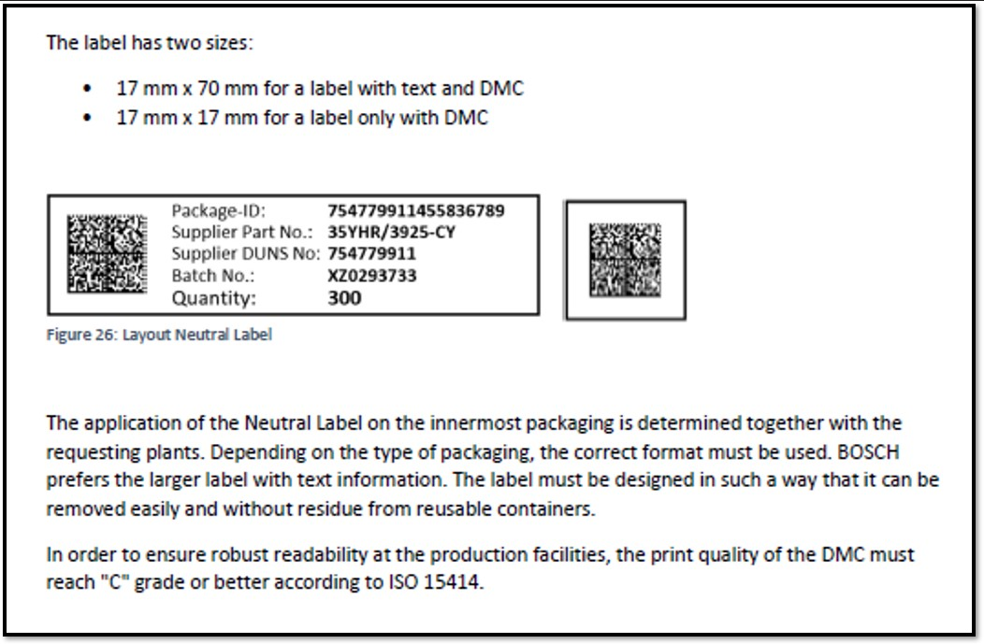
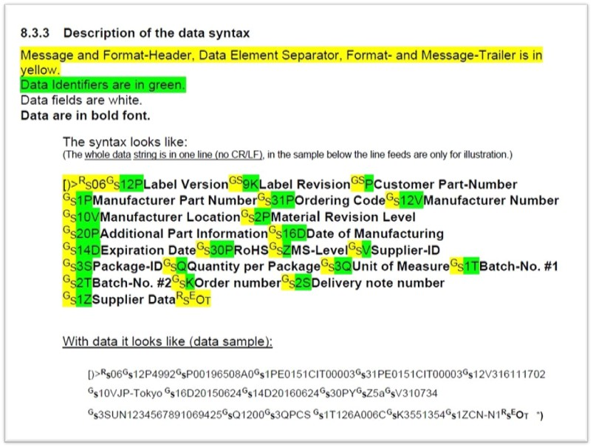
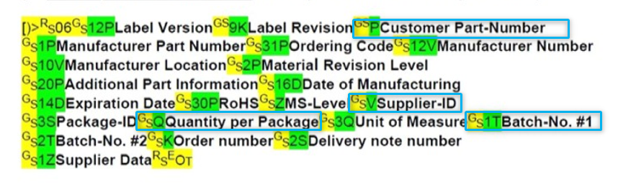

2-Dimensional Labels - Preferred
Mandatory Information
P = Part number
Q = Quantity (qty in subpack)
V = Vendor
1T = Batch
Label Specifications
The 2-Dimensional labels have an output in the form shown below.
  This data is one continuous string, with the information segmented as shown below.
These 2-Dimensional labels have 2 possible forms, which are shown below along with BOSCH specifications and dimensions.
Sample string:
~d029PF03Z200338-05~d029V97455616~d029Q50~d0291T2609236~d030~d004

Slide 6
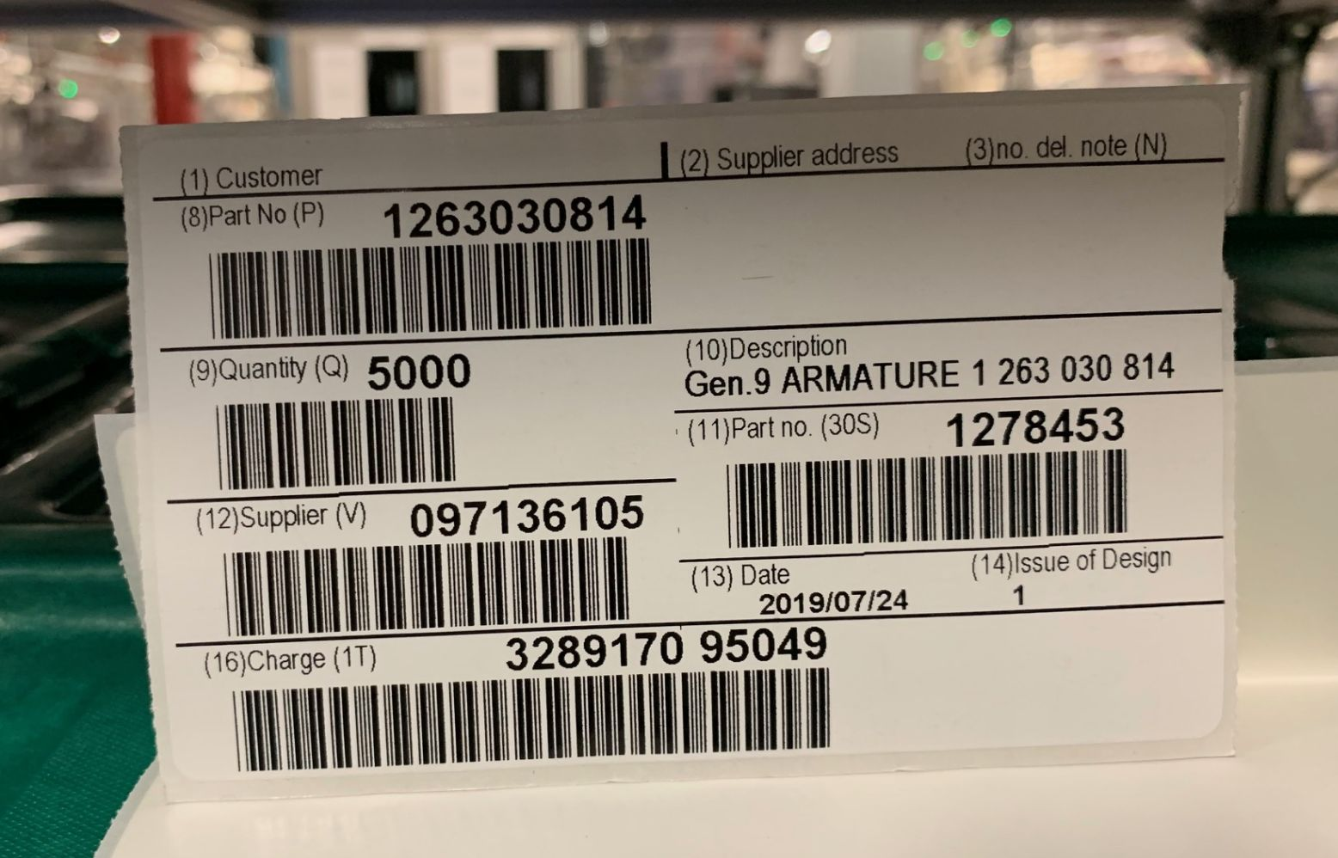
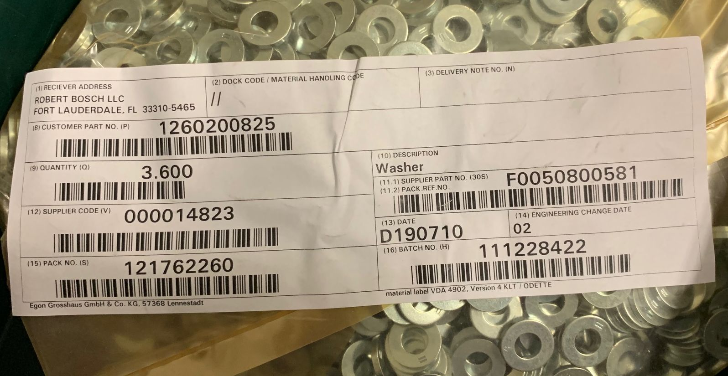
1-Dimensional Labels
Label Specifications
1-dimensional label sets come in the form shown.
Both of these label sets need the highlighted barcodes to be scanned at stations which use B-level component for traceability.
Mandatory Information
P = Part number
Q = Quantity (specific to quantity inside labeled subpack)
V = Vendor
1T = Batch
f

Slide 7
Manual and Standards - Highlights
ChP PS-EM Logistics
From NA Supplier Packaging & Labeling Standards:
2.3 Design considerations
  2.3.2 Any expendable packaging must protect parts from quality issues such as corrosion, contamination, and damage under any INCOTERM conditions. Resulting costs from contaminated or damaged parts will not be accepted by Bosch.
2.7 Returnable Packaging
  2.7.5 Supplier is responsible for product integrity regarding corrosion and must propose different alternatives to protect parts until point of use.
  2.7.11 The supplier is responsible for cleanliness of returnable packaging, unless otherwise expressly agreed with Bosch at the receiving Bosch facilities. Written agreement required from Bosch Purchasing and Logistics.
From Supplier Logistics Manual | Version 6.0:
3.1.6 Corrosion prevention and moisture control
  Materials or products susceptible to corrosion must be protected during transportation and storage according to the prevailing external conditions (e.g. high relative humidity or for sea transportation). Corrosion protection medium has to be agreed between BOSCH and SUPPLIER and documented in the PDS.
https://www.bosch.com/company/supply-chain/information-for-business-partners/

